Slide 1
PHUSE Poster - Standard Analysis and Code Sharing Working Group (6 Working teams)
Snip each slide and make it a section on the poster – fit as best able

Slide 2
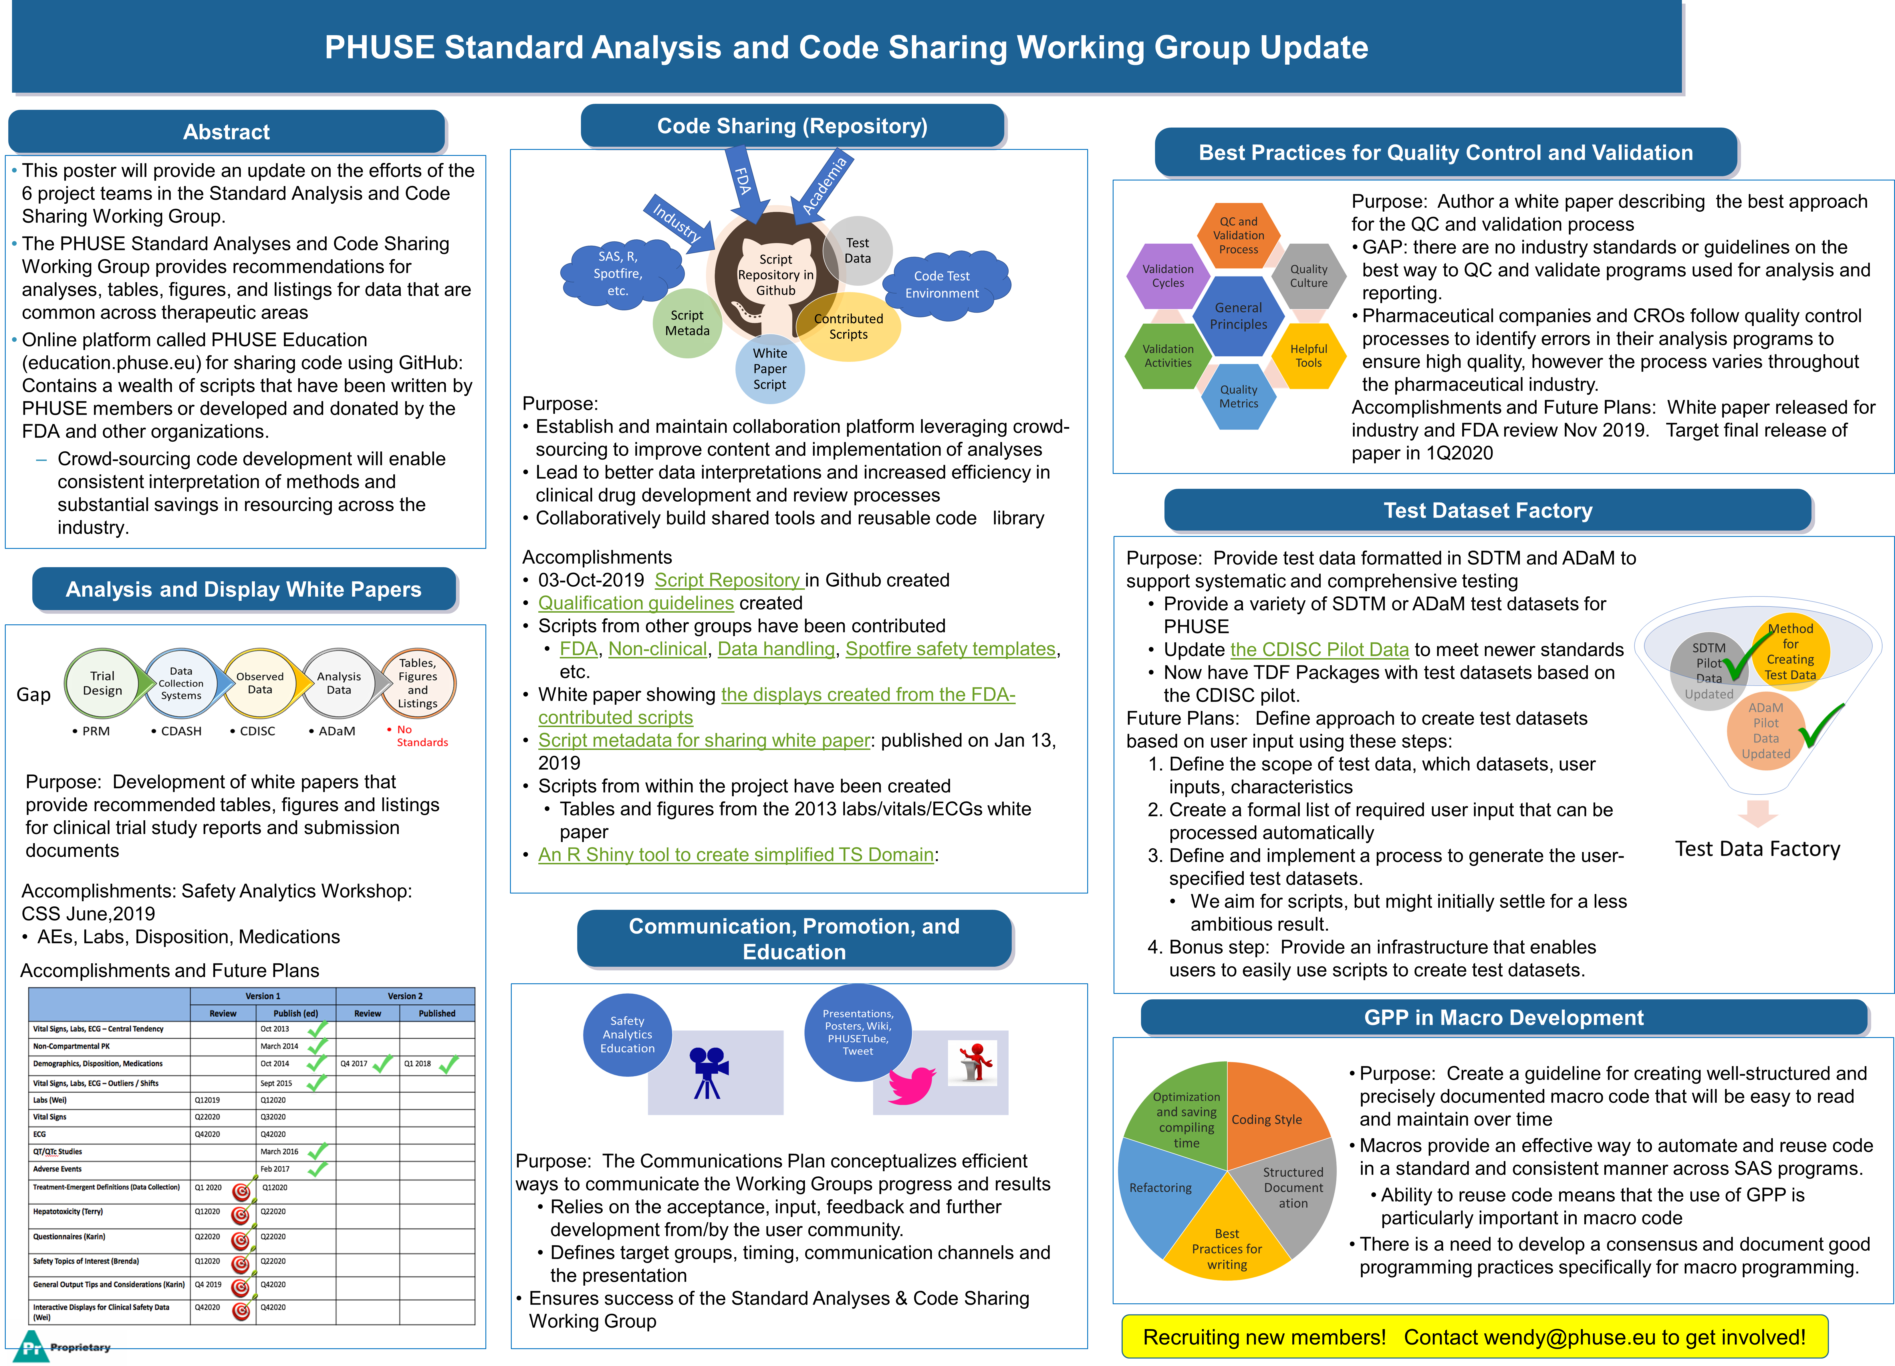


Slide 3
Standard Analysis and Code Sharing Working Group (6 project teams)
The PHUSE Standard Analyses and Code Sharing Working Group provides recommendations for analyses, tables, figures, and listings for data that are common across therapeutic areas
Online platform called PHUSE Education (education.phuse.eu) for sharing code using GitHub: Contains a wealth of scripts that have been written by PHUSE members or developed and donated by the FDA and other organizations.
Crowd-sourcing code development will enable consistent interpretation of methods and substantial savings in resourcing across the industry.
This poster will provide an update on the efforts of the 6 project teams in the Standard Analysis and Code Sharing Working Group.
Laboratory Measurements
Vital Signs
Electrocardiograms
Adverse Events
Demographics
Medications
Disposition
Hepatotoxicity
Pharmacokinetics

Slide 4
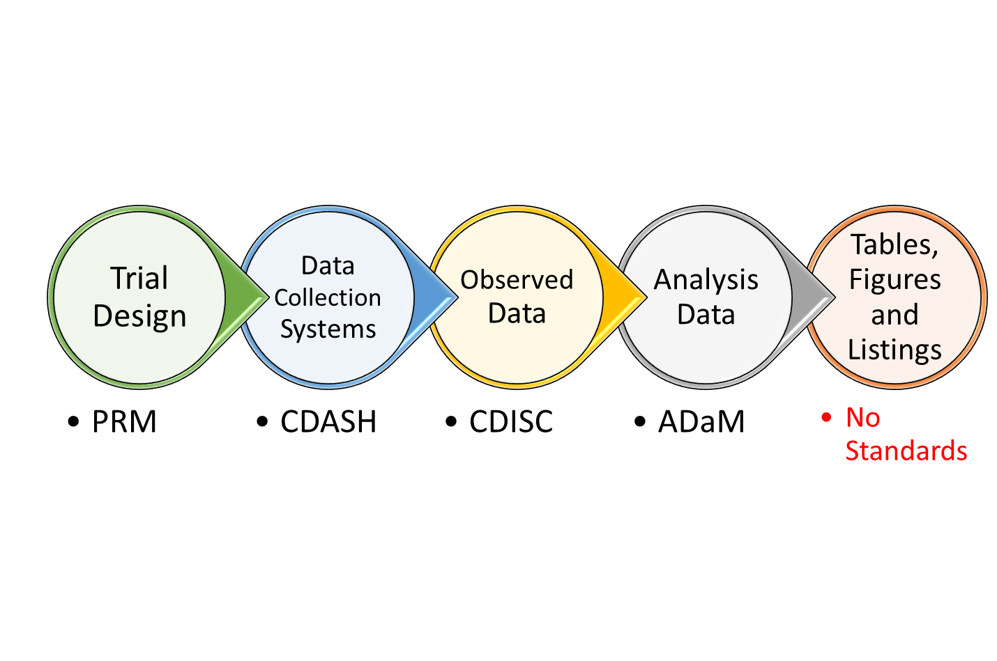
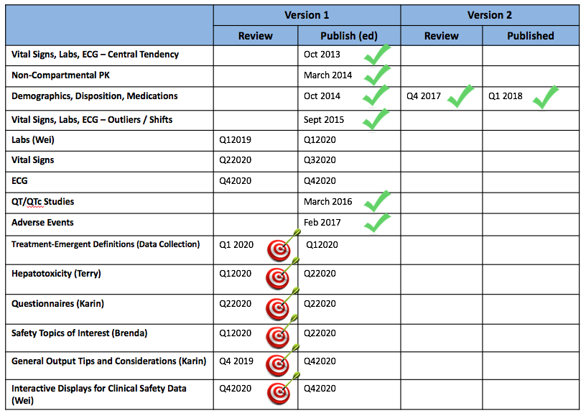
Analysis and Display White Papers
Gap
Accomplishments and Future Plans
Purpose: Development of white papers that provide recommended tables, figures and listings for clinical trial study reports and submission documents
Accomplishments: Safety Analytics Workshop: CSS June,2019
AEs, Labs, Disposition, Medications
Recruiting new members!
Contact wendy@phuse.eu to get involved!

Slide 5
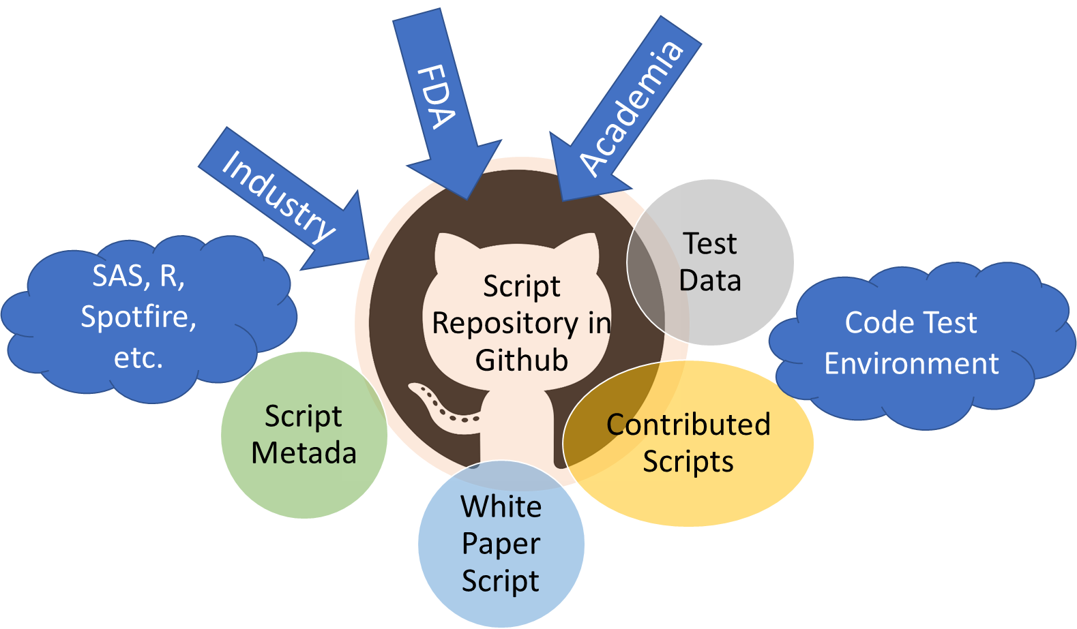
Code Sharing (Repository)
Purpose:
Establish and maintain collaboration platform leveraging crowd-sourcing to improve content and implementation of analyses
Lead to better data interpretations and increased efficiency in clinical drug development and review processes
Collaboratively build shared tools and reusable code library
Accomplishments
03-Oct-2019 Script Repository in Github created
Qualification guidelines created
Scripts from other groups have been contributed
FDA, Non-clinical, Data handling, Spotfire safety templates, etc.
White paper showing the displays created from the FDA-contributed scripts
Script metadata for sharing white paper: published on Jan 13, 2019
Scripts from within the project have been created
Tables and figures from the 2013 labs/vitals/ECGs white paper
An R Shiny tool to create simplified TS Domain:
Recruiting new members! Contact wendy@phuse.eu to get involved!

Slide 6
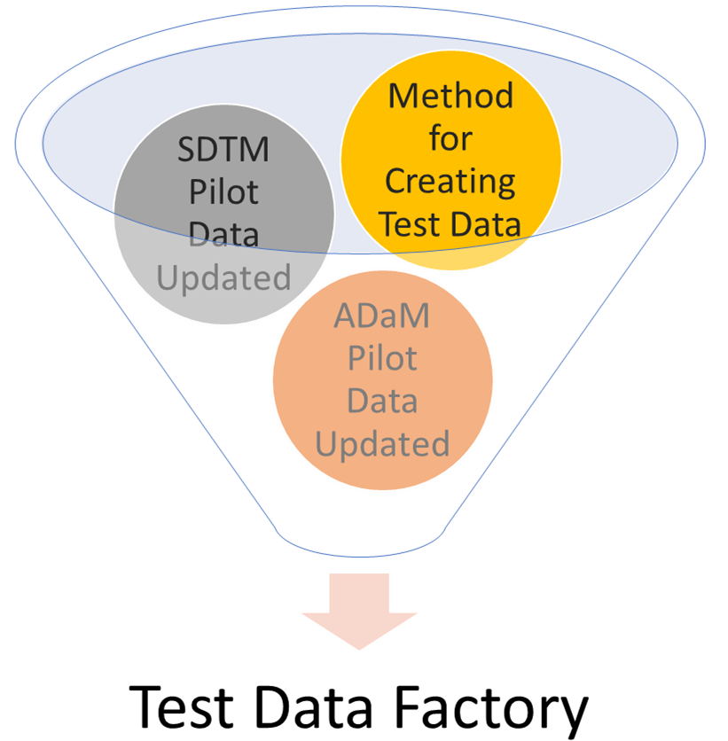

Test Dataset Factory
Purpose: Provide test data formatted in SDTM and ADaM to support systematic and comprehensive testing
Update the CDISC Pilot Data to meet newer standards
Mechanism to create customized SDTM or ADaM databases
Achievement:
Updated TDF Package based on the CDISC pilot has been released
Next steps: Design mechanism to create custom databases:
Ongoing: Define scope for custom databases: domains, variables, etc
Ongoing: Create a user-configuration input form
Ongoing: SAS and R code to create custom databases
Recruiting new members!
Contact wendy@phuse.eu to get involved!

Slide 7
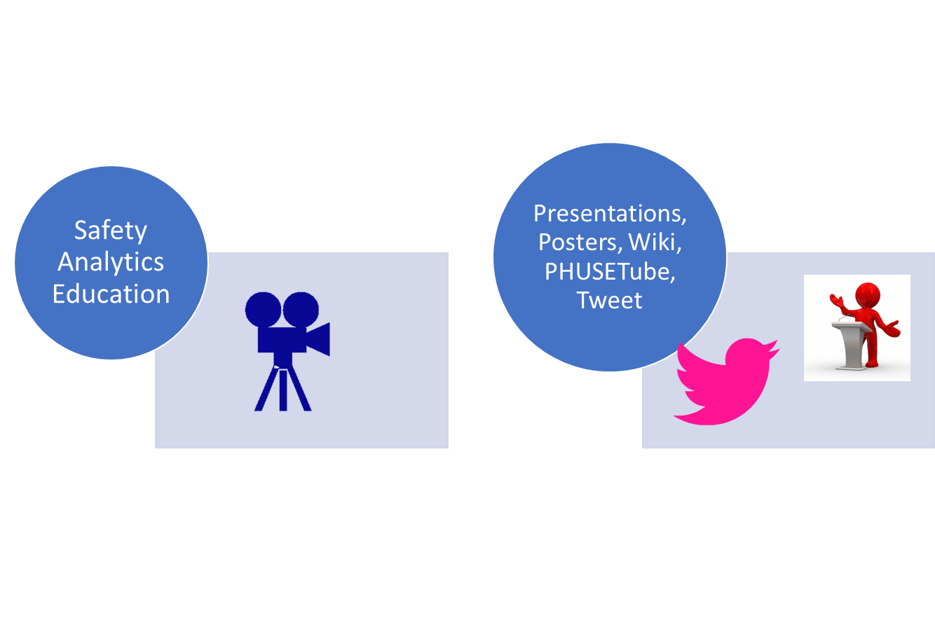
Communication, Promotion, and Education
Purpose: The Communications Plan conceptualizes efficient ways to communicate the Working Groups progress and results
Relies on the acceptance, input, feedback and further development from/by the user community.
Defines target groups, timing, communication channels and the presentation
Ensures success of the Standard Analyses & Code Sharing Working Group
Recruiting new members!
Contact wendy@phuse.eu to get involved!

Slide 8
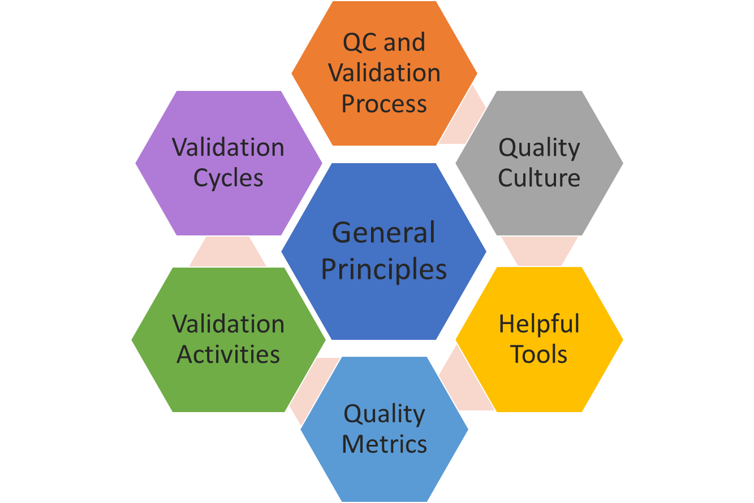
Best Practices for Quality Control and Validation
Purpose: Author a white paper describing the best approach for the QC and validation process
GAP: there are no industry standards or guidelines on the best way to QC and validate programs used for analysis and reporting.
Pharmaceutical companies and CROs follow quality control processes to identify errors in their analysis programs to ensure high quality, however the process varies throughout the pharmaceutical industry.
Accomplishments and next steps: White paper released for industry and FDA review Nov 2019. Target final release of paper in 1Q2020
No longer recruiting members

Slide 9
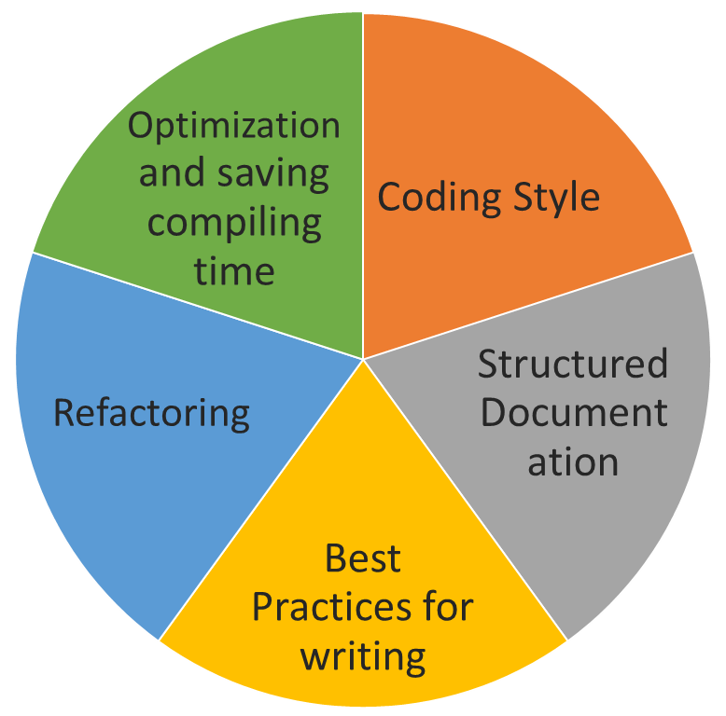
GPP in Macro Development
Purpose: Create a guideline for creating well-structured and precisely documented macro code that will be easy to read and maintain over time
Macros provide an effective way to automate and reuse code in a standard and consistent manner across SAS programs.
Ability to reuse code means that the use of GPP is particularly important in macro code
There is a need to develop a consensus and document good programming practices specifically for macro programming.
Recruiting new members!
Contact wendy@phuse.eu to get involved!

Slide 10
WORKING SLIDES

Slide 11
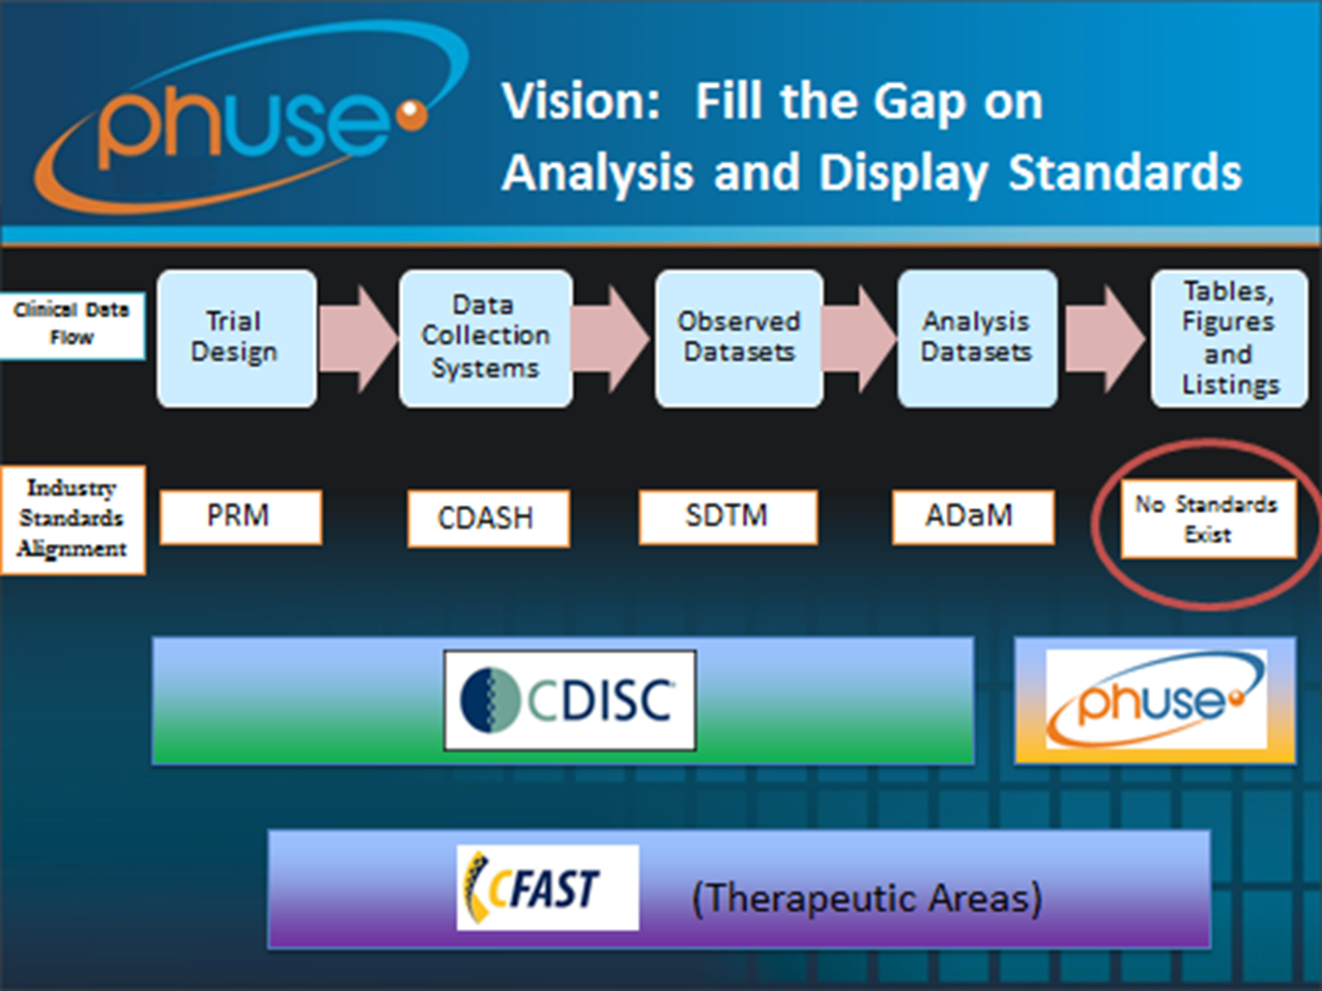
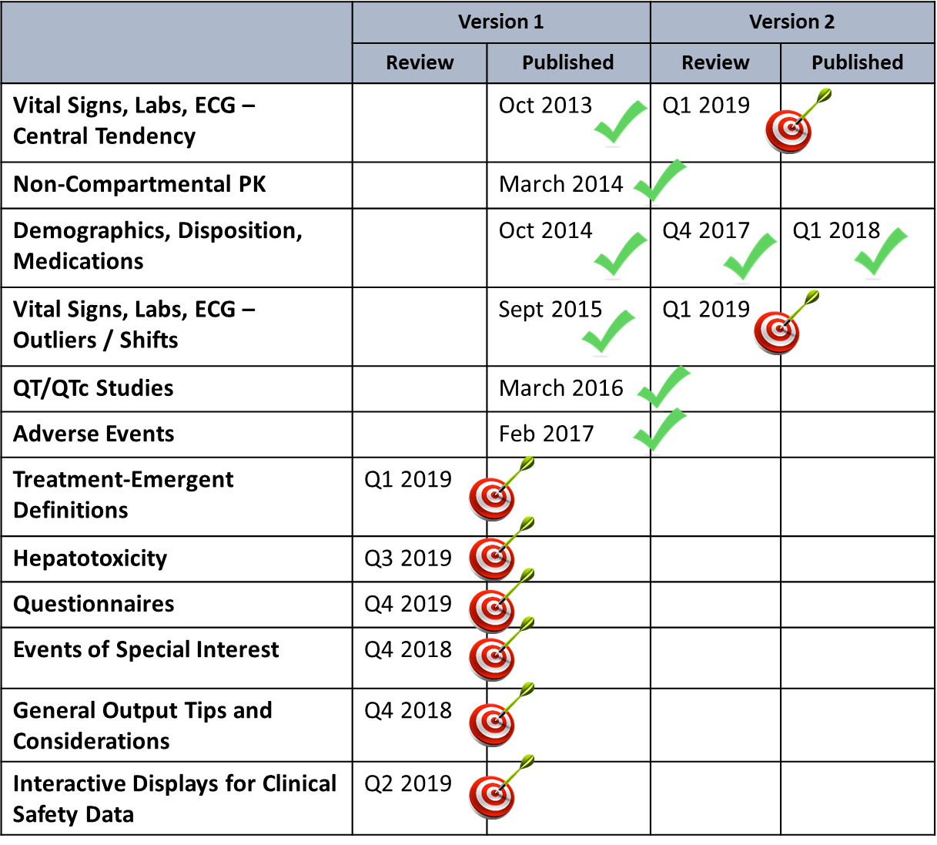
Analysis and Display White Papers

Slide 12
Analysis and Display White Papers
Trial Design
PRM
Data Collection Systems
CDASH
Observed Data
CDISC
Analysis Data
ADaM
Tables, Figures and Listings
No Standards

Slide 13
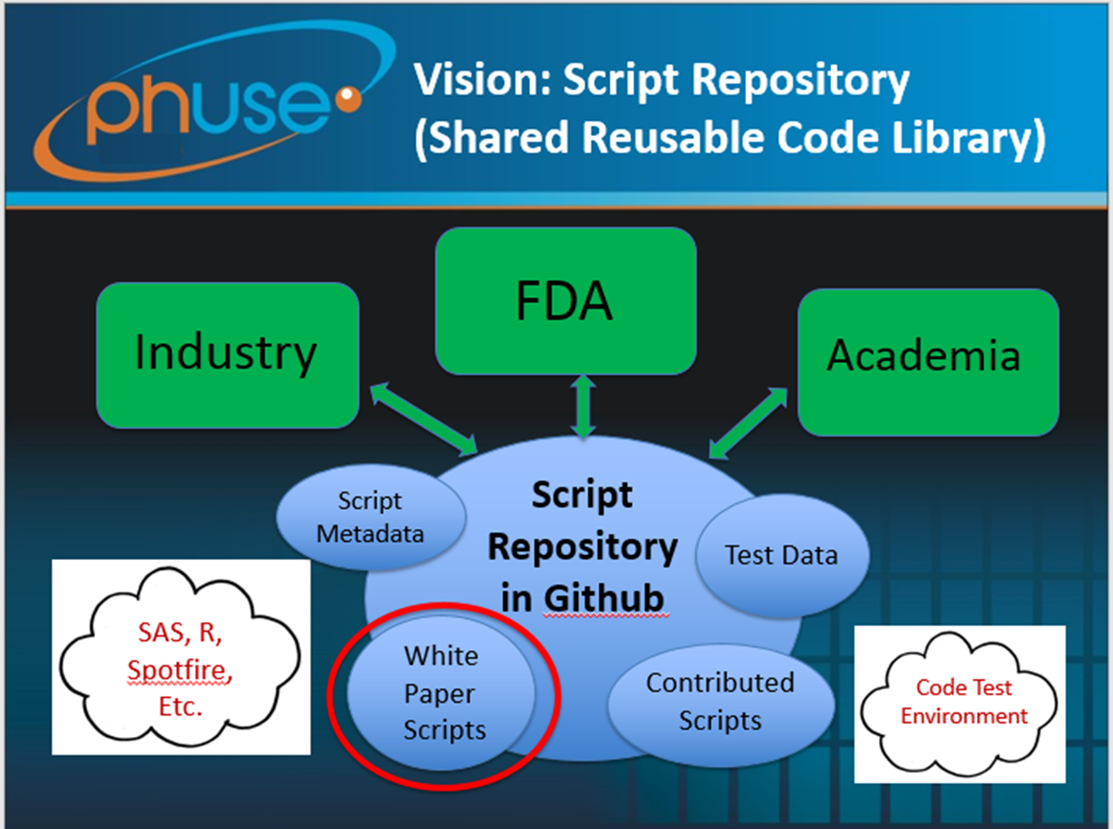
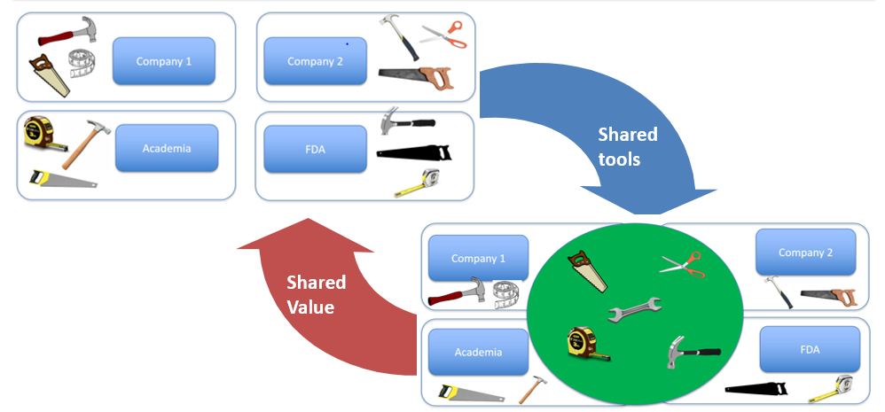
Code Sharing (Repository)

Slide 14

Code Sharing (Repository)
Academia
Script Repository in Github
Test Data
Contributed Scripts
White Paper Script
Script Metada
FDA
Industry
SAS, R, Spotfire, etc.
Code Test Environment

Slide 15
Test Data Factory
The Test Dataset Factory project aims to provide test data formatted in SDTM and ADaM that support a more systematic and comprehensive testing of these concepts and scripts.
Use this instead of typical fallback of using data from the CDISC pilot project and/or anonymised study data.
Provide a variety of SDTM or ADaM test datasets to support testing of PHUSE Working Group projects who are developing medical research methods, features, or processes, software components or sub-systems
Status:
Updated SDTM Pilot Data
Updated ADaM Pilot Data
Vision: Method for Creating Test Data for Specific Needs

Slide 16
Test Data Factory
Method for Creating Test Data
ADaM Pilot Data Updated
Test Data Factory
SDTM Pilot Data Updated

Slide 17



Communication, Promotion, and Education
Safety Analytics Education
Presentations, Posters, Wiki, PHUSETube, Tweet
The success of the Standard Analyses & Code Sharing Working Group relies on the acceptance, input, feedback and further development from/by the user community. The Communications Plan conceptualises efficient ways to communicate Working Group progress and results, e.g. via white papers and the call for scripts. This project defines target groups, timing, communication channels and the presentation

Slide 18
Best Practices for Quality Control and Validation
General Principles
QC and Validation Process
Quality Culture
Helpful Tools
Quality Metrics
Validation Activities
Validation Cycles

Slide 19
Coding Style
Structured Documentation
Best Practices for writing
Refactoring
Optimization and saving compiling time

Slide 21

FDA
Industry
Academia
SAS, R, Spotfire, Etc.
Script Repository in Github
Code Test Environment
Script Metadata
Test Data
Best Practices for QC and Validation
Macro Development
White Paper Scripts
Contributed Scripts

Slide 22
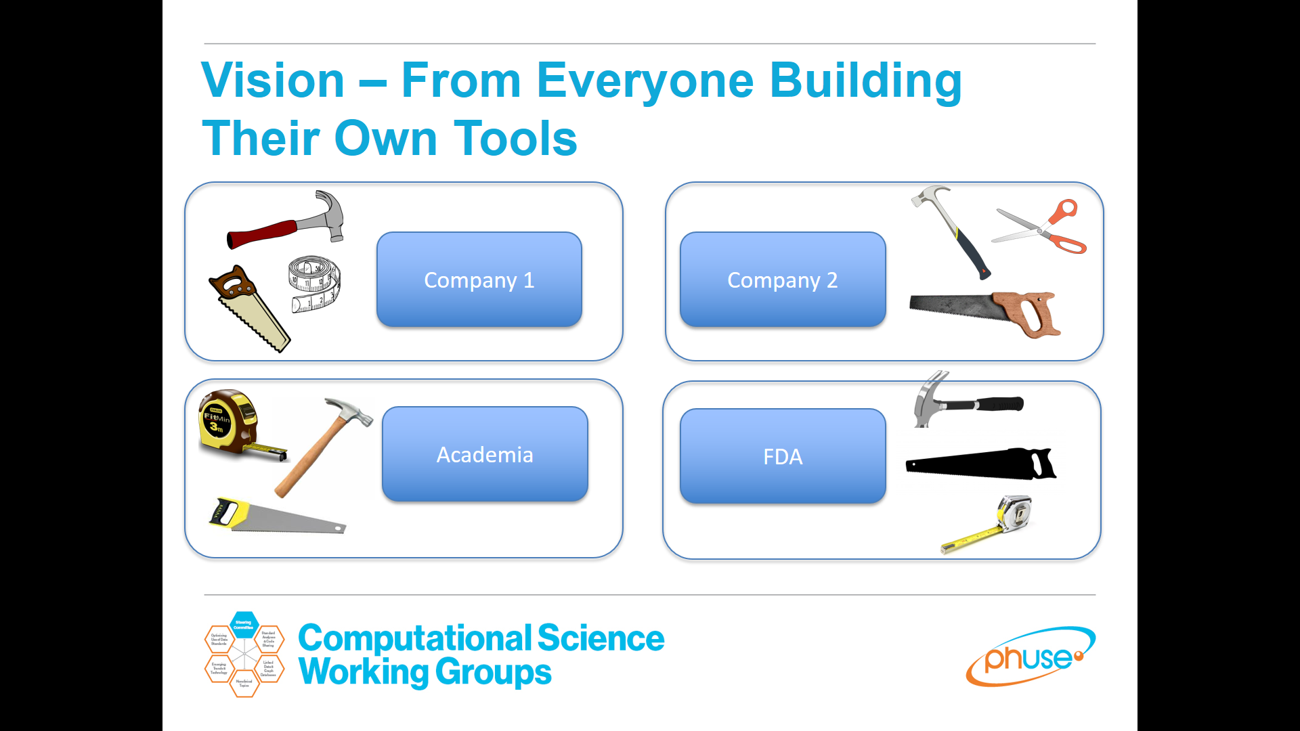
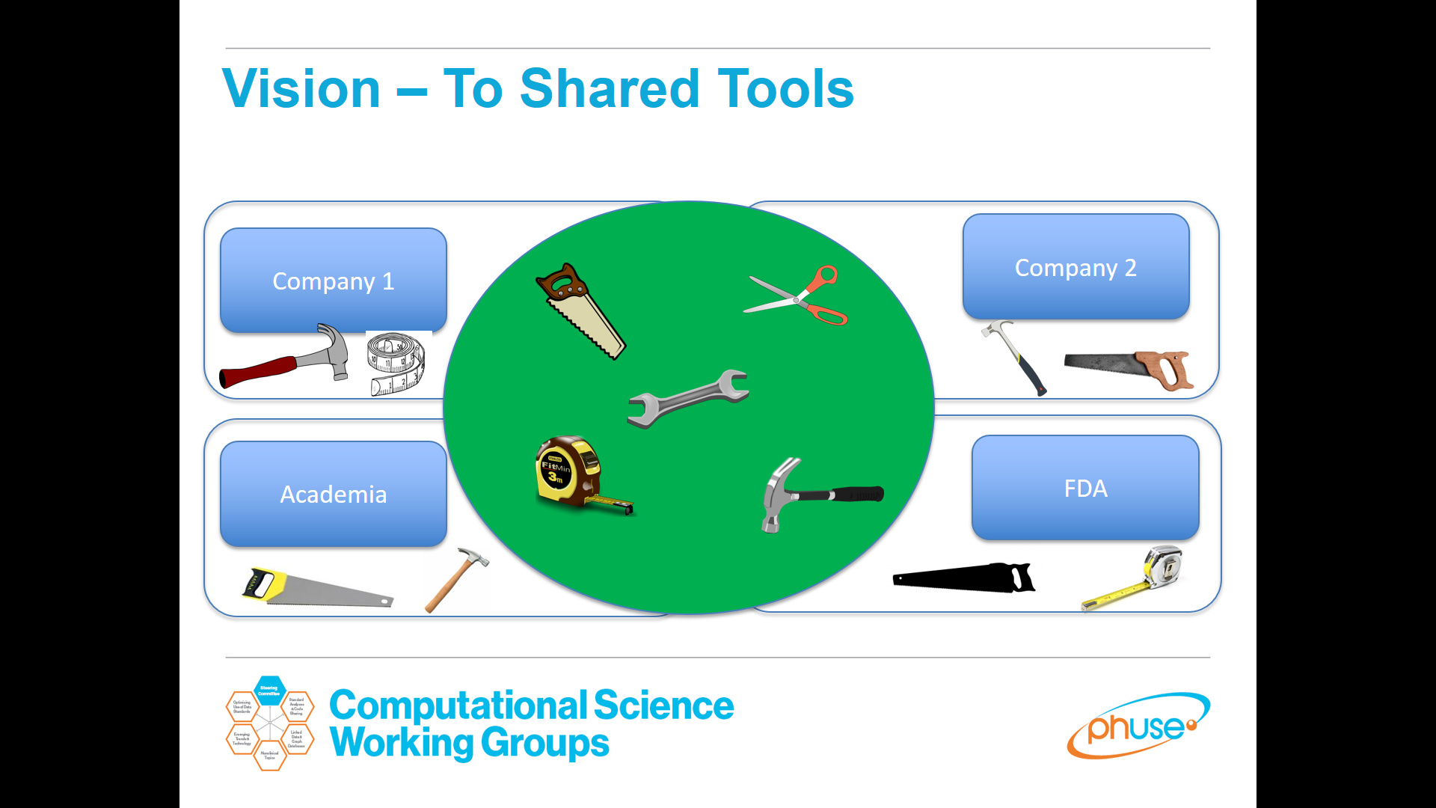
Shared tools
Text
Shared Value

